Slide 1


Slide 2
In This Chapter, We will Address
What are customer value , satisfaction and loyalty and how can companies deliver them?
What is the life time value of customers, and how can marketers maximize it?
How can companies attract and retain the right customers and cultivate strong customer relationships?

Slide 3
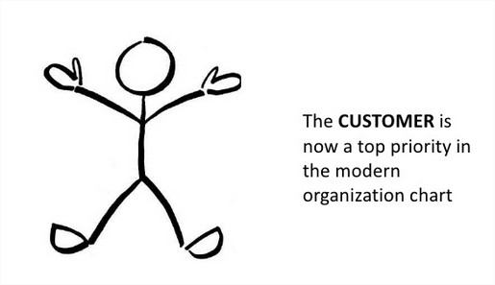
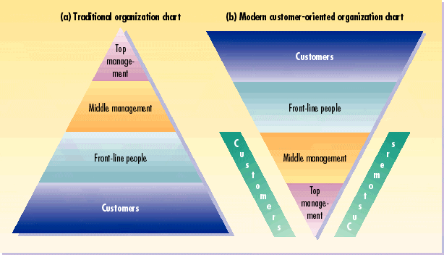
Traditional versus Modern Organization Chart

Slide 4
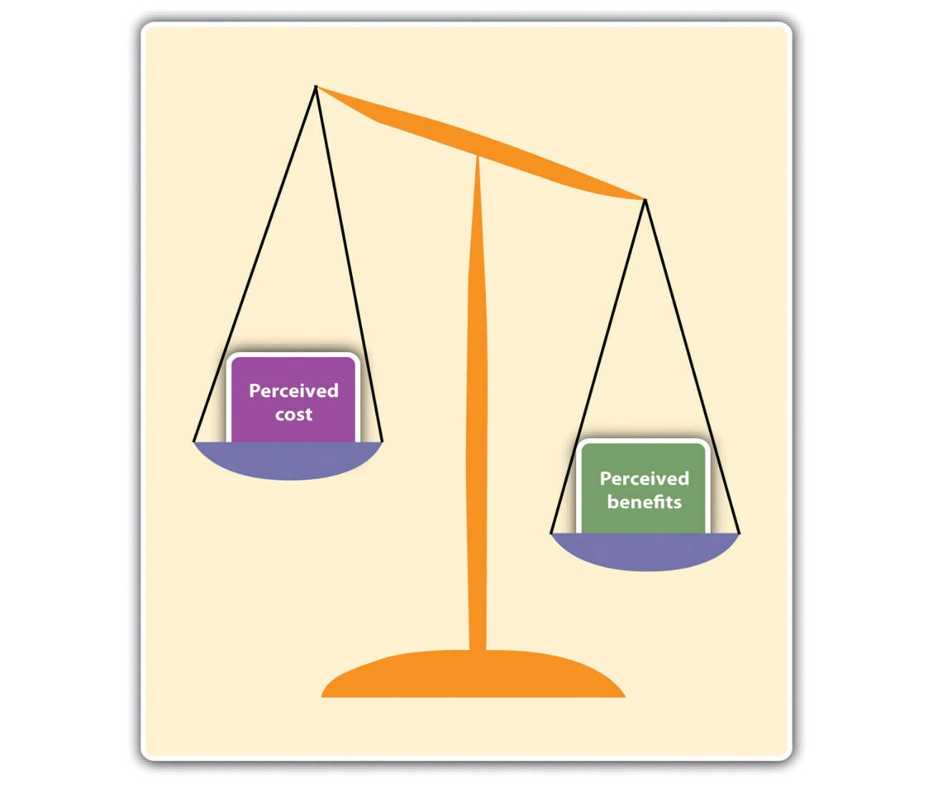
Customer Perceived value
It is the DIFFERENCE between all benefits and all costs of an offering and the perceived alternatives
Total customer benefits is the perceived monetary value of bundle of economic, functional, and psychological benefits the customers expects from a given market offering of the product, service, people and image
Total customer cost is the perceived bundle of costs customers expect to incur in evaluating, obtaining, using and disposing of a given market offering including monetary , time ,energy and psychological costs

Slide 5
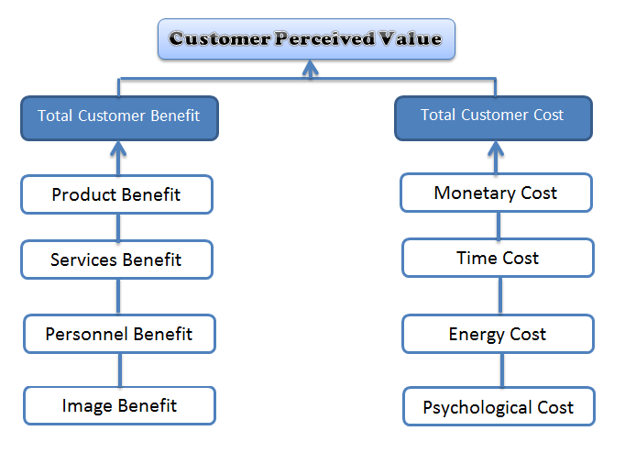
Determinants of customer-perceived value

Slide 6
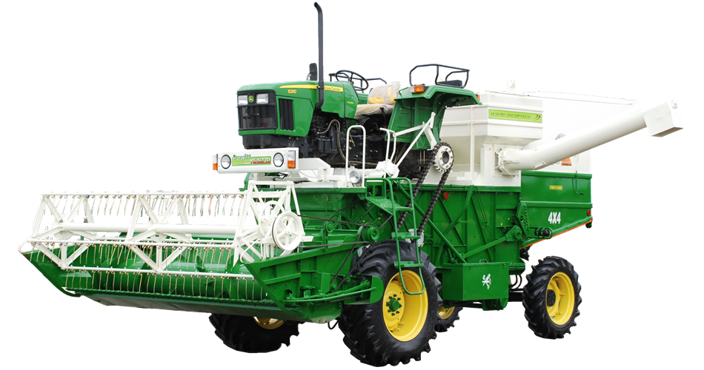

Applying value concepts
A large construction company wants to buy a tractor for construction from either Mahindra or John Deere
He wants the tractor to deliver certain levels of reliability , durability , performance , and Resale value.
To win the sale, the firm must offer more customer perceived value

Slide 7
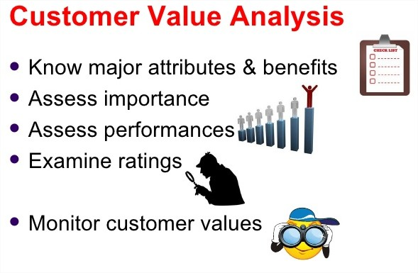

Slide 8
Choice processes and implications
Some marketers might argue the process and go for John Deere tractor, here are 3 possibilities :
1. The buyer might be under orders to buy at the lowest price
2. The buyer will retire before the company realizes the John Deere tractor is more expensive to operate
3. The buyer enjoys a long-term friendship with the John Deere salesperson

Slide 9
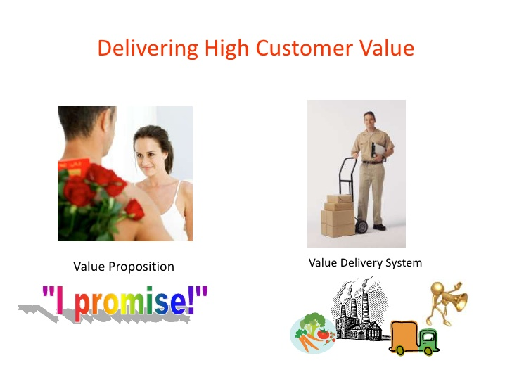

Slide 10

Value proposition : Consists of the whole cluster of benefits the company promises to deliver, it is more than the core positioning of the offering Example : Volvo’s core positioning has been “safety” but the buyer is promised more than just a safe car and other benefits include good performance, design

Slide 11

Value delivery system : Includes all the experiences the customer will have on the way to obtaining and using the offering A good value delivery system is a set of core business processes that help deliver distinctive customer value

Slide 12
Delivering Superior customer value
Customer Value Management at TATA Steel ”by DVR Sheshadri and
Arabinda tripathy, with Peeush Gupta and Subodh Pandy;
IIM Ahmedabad, and IIM Bangalore, 2004 ”

Slide 13

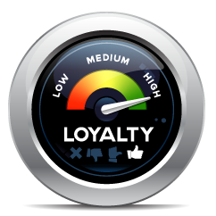
Oliver defines loyalty as –A deeply held commitment to rebuy a preferred product or service in the future despite situational influences and marketing efforts having the potential to cause switching behavior.

Slide 14
Total customer Satisfaction
Satisfaction is a person’s feelings of pleasure or disappointment that result from comparing a product’s perceived performance to expectations
If performance falls short of expectations, customer is dissatisfied
If it matches expectations, the customer is satisfied
If it exceeds expectations, the customer is highly satisfied or delighted

Slide 15
Maximizing customer Lifetime value
Marketing is the art of attracting and keeping profitable customers, but every company loses money on some of its customers
Pareto’s 80-20 rule
The company could improve its profits by “firing” its worst customers
A profitable customer is a person, household, or company that over time yields a revenue stream exceeding by an acceptable amount the company’s cost stream for attracting, selling, and serving that customer

Slide 16
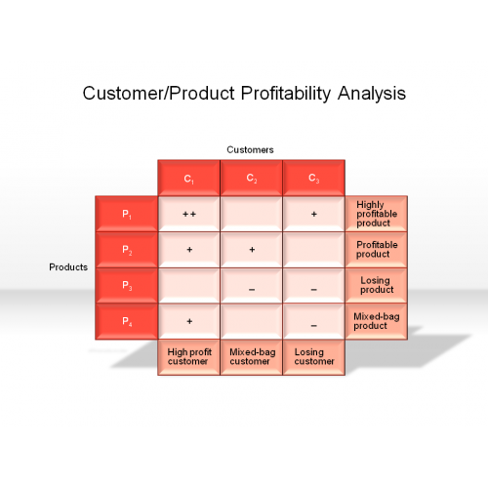
Customer Profitability Analysis (CPA) is best conducted with the tools of an accounting technique called activity-based costing (ABC) ABC accounting tries to identify the real costs associated with serving each customer

Slide 17

Measuring Customer Lifetime Value
Customer Lifetime Value (CLV) describes the net present value of the stream of future profits expected over the customer’s life time purchases
Researchers and practitioners have used many different approaches for modeling and estimating CLV
where p_{t} : price paid by customer
C_{t} : direct cost of servicing the customer
I : discount rate
r_{t} : profitability of customer repeat buying
AC : Acquisition cost
T : time horizon for estimating CLV

Slide 18
Cultivating Customer Relationships
Customer relationship management (CRM) is the process of carefully managing detailed information about individual customers and all customer “touch points” to maximize customer loyalty.
Touch point—any occasion on which a customer encounters the brand and product.

Slide 19
Framework for CRM by Don Peppers and Mrtha Roger
Identify your prospects and customers.
Differentiate customers in terms of their needs and their value to your company- Identify most valuable customer (MVC)
Interact with individual customers to improve knowledge about their individual needs and to build stronger relationship.
Customize products, services, and messages to each customer

Slide 20
Importance of CRM
PARETO’S LAW
80:20 RULE
20% of customer account for 80% of turn over
20% of customer account for 80% of profit
20% of customer account for 80% of all your problems

Slide 21
Acquisition is not the same as retention
Sales analysis
Customer service
Product quality
Customer segmentation
Acquisition
Retention
advertising
Trust and privacy
merchandising
Channel support
Campaign management
Customer satisfaction

Slide 22
The Customer Development Process
Potentials
Prospects
First-time customers
Repeat customers
Clients
Members
Advocates
Partners

Slide 23
Building Loyalty
Interact with customers
Develop loyalty programs
Frequency programs
Club membership programs
Personalize marketing
Create institutional ties

Slide 24
Loyalty is about the conscious decision of your customers to commit their continual repurchases to your brand. It is :
Driving an extra few miles to do your shopping
Recommending it to your best friend
An emotional and rational ‘lock-in’
Sometimes encouraged by an incentive or reward
A better path to profit
Loyalty is essentially a one-way commitment for which the customer receives a reward, but it is also about relationships
Two-way interaction in which both sides create and exchange mutual benefits

Slide 25
CRM Strategies
Acquisition of customers can cost 5 times more than retaining current customers.
The customer profit rate increases over the life of a retained customer.
CRM Strategies:
Reduce rate of defection
Increase longevity
Enhance share of wallet
Terminate low-profit customers
Focus more effort on high-profit customers

Slide 26
Table 5.1 Mass vs. One-to-One Marketing
Mass
Average customer
Customer anonymity
Standard product
Mass production
Mass distribution
Mass advertising
One-way message
Economies of scale
One-to-One
Individual customer
Customer profile
Customized market offering
Customized production
Economies of scope
Share of customer

Slide 27
Describing Market Dynamics
Permanent capture markets
Simple retention markets
Customer migration markets

Slide 28
Building Loyalty
Basic
Reactive
Accountable
Proactive
Partnership

Slide 29
Reducing Customer Defection
Define and measure retention rate
Distinguish causes of customer attrition
Estimate profit loss associated with loss of customers
Assess cost to reduce defection rate
Gather customer feedback

Slide 30
Forming Strong Customer Bonds
Add financial benefits
Add social benefits
Add structural ties

Slide 31
Database Key Concepts
Customer database
Database marketing
Mailing list
Business database
Data warehouse
Data mining

Slide 32
Using the Database
To identify prospects
To target offers
To deepen loyalty
To reactivate customers
To avoid mistakes

